Slide 1

IT initiatives
@ Madhya Pradesh State Election Commission
http://mplocalelection.gov.in/
Follow us @
commissionersec@gmail.com
Facebook.com/mplocalelection

Slide 2

Various IT initiatives
Dynamic website
Integrated election management system
Online candidate nominations (OLIN)
Integrated polling information system
Photo electoral roll/ Online voter registration
“Chunav” mobile app
Geographical Information System (GIS)
EVM tracking and management System
Material management system
Budget management system
Court case management system

Slide 3
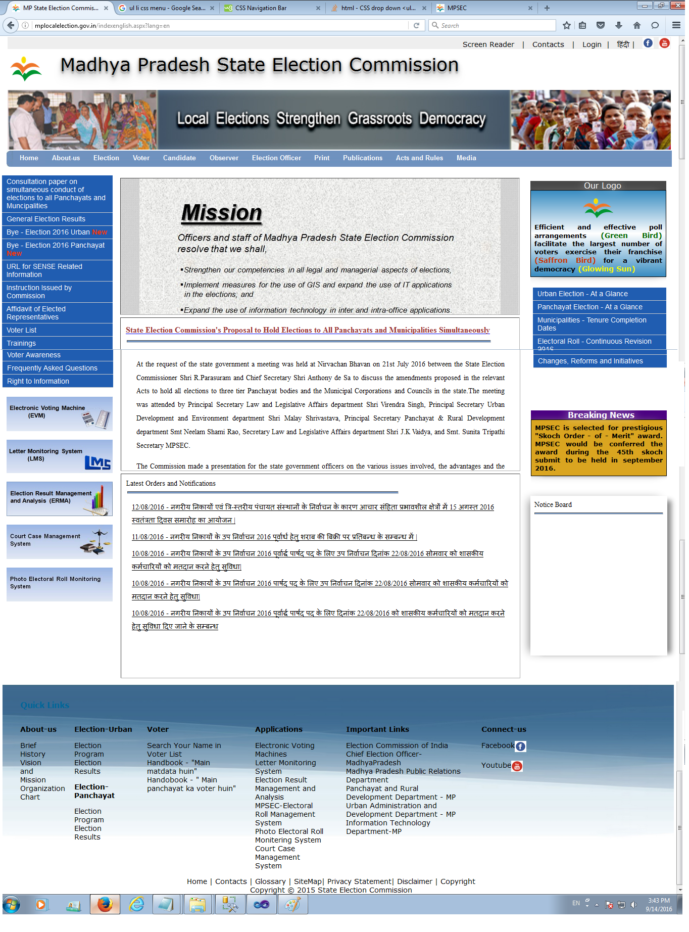
Content management system based website
  URL - http://mplocalelection.gov.in
  Dynamic website supported by content management system
  Useful for various users like voter, candidate, election officials etc.
  Provide various information, circulars, instructions, handbooks etc. useful for the officials.
  Provide information like candidate details, affidavit, results, GIS portal etc. useful for voters and candidates.
  Regularly updated

Slide 4
Integrated Election Management System (IEMS)
Election program declaration
Election notification
Candidate nomination
Candidate scrutiny
Symbol allotment
Poll day monitoring
Result declaration
Generate praroops and certificates

Slide 5
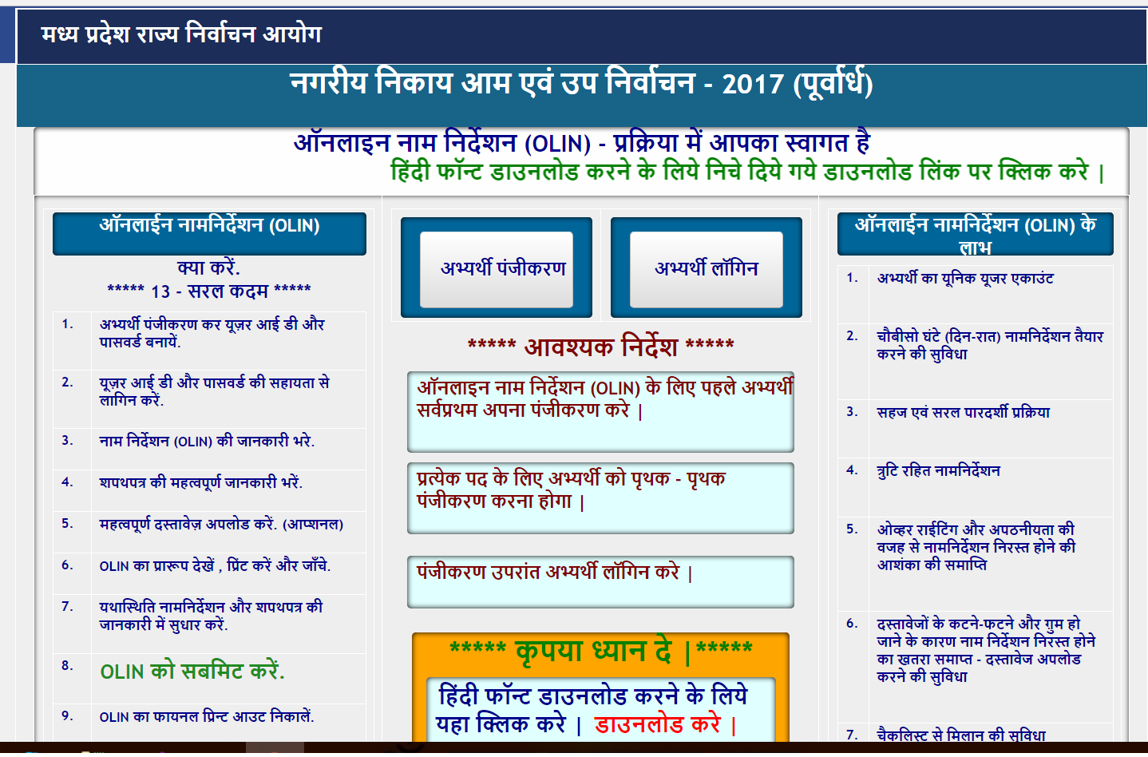
Online nominations (OLIN)
  Online mechanism for candidates to fill nominations from anywhere anytime during nomination period
  Candidate need to submit signed printout to RO
  Candidate need to enter summary affidavit
  Comparison chart of candidates generated and pasted on polling stations to enable informed choice by voters

Slide 6

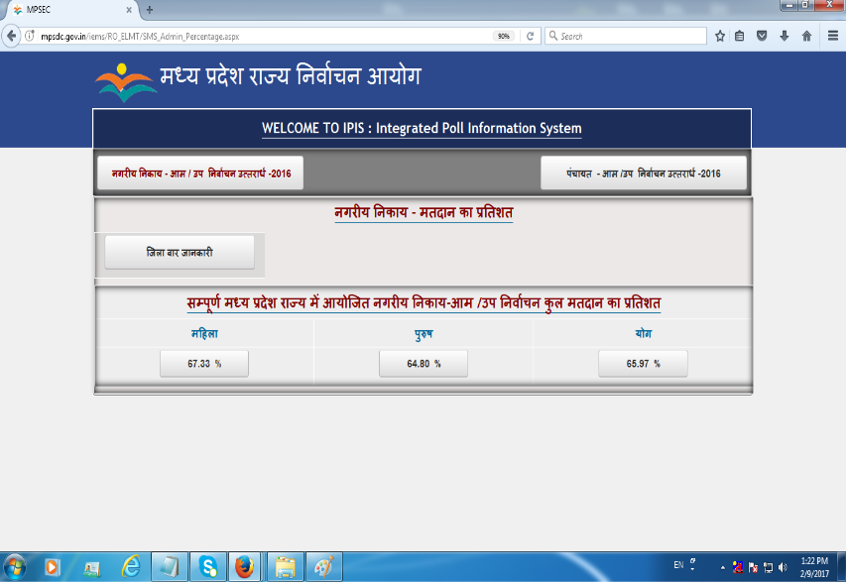
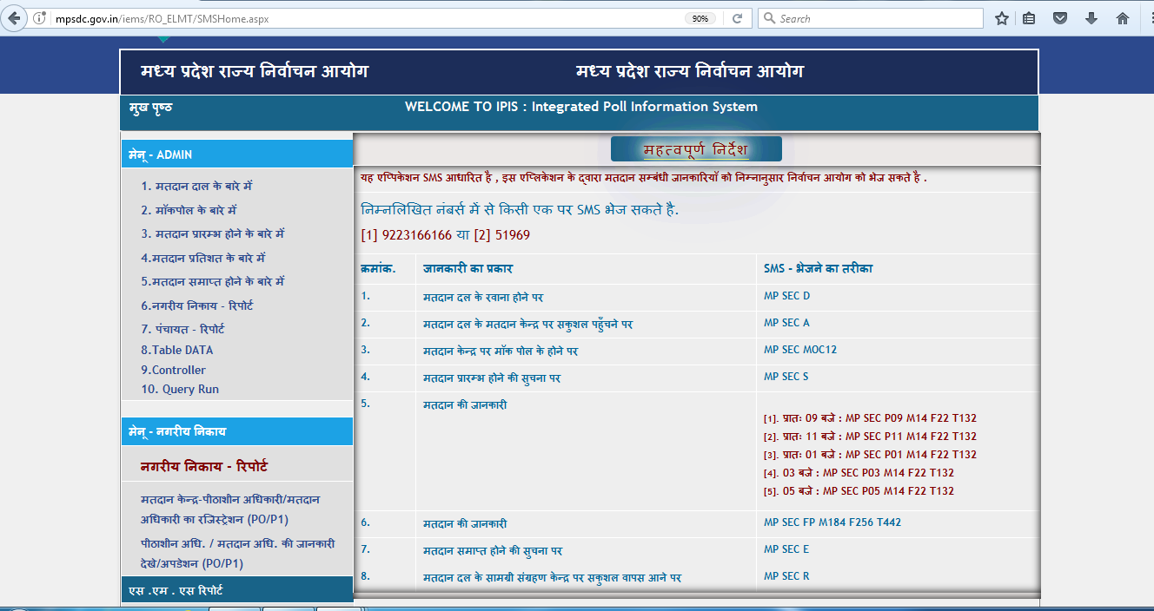
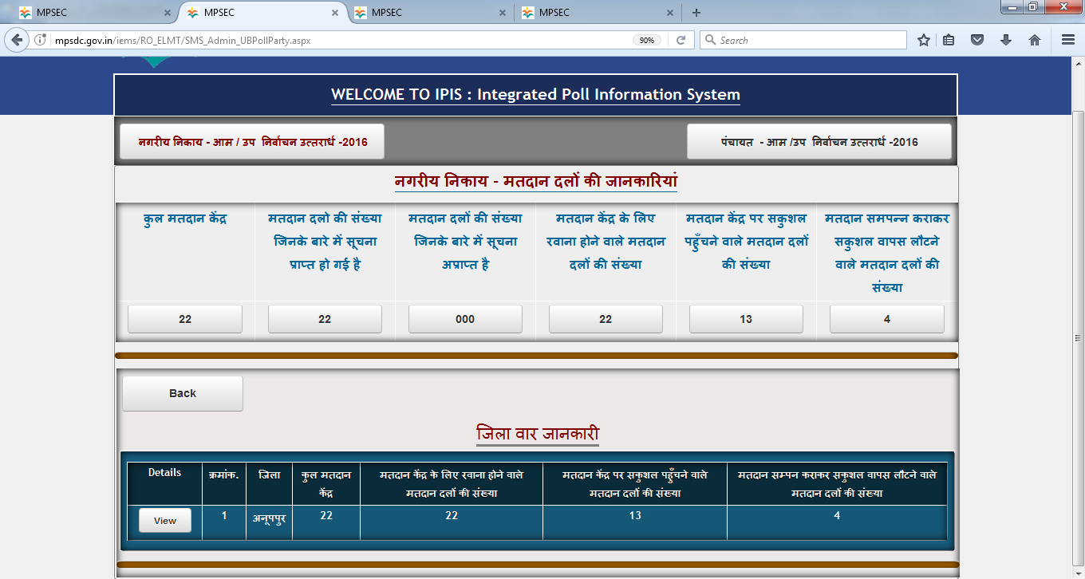
Integrated Polling Information System (IPIS)
Information collection using SMS
  Mock poll report
  Polling party departure and arrival report
  Polling start and end report
  Polling percentage on two hours interval

Slide 7
Photo electoral roll
Old electoral roll
Photo electoral roll
Shifting of voters using electoral roll management system

Slide 8
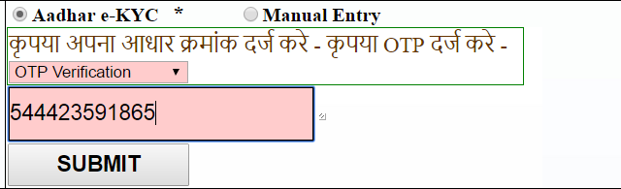
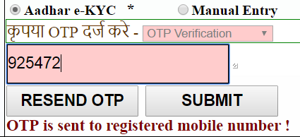
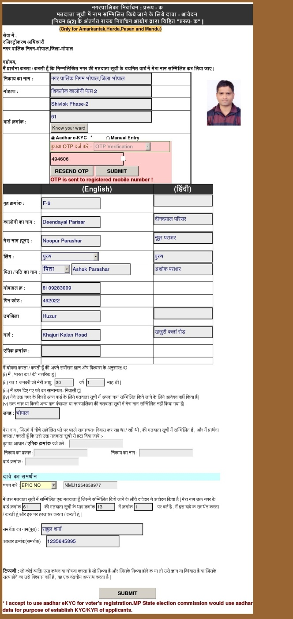

Online voter registration

Slide 9
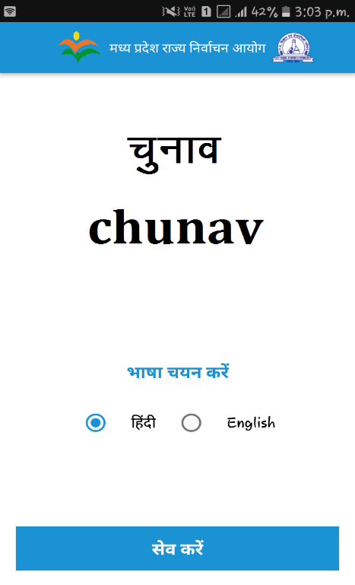
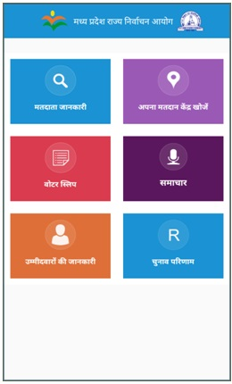
“Chunav” Mobile App
  Useful for voters for-
  Voter list search
  Locate polling station and get directions on Google map
  E-Voter Slip
  Candidate information
  Election results
  Important news
  Freely available on google play store and website.

Slide 10
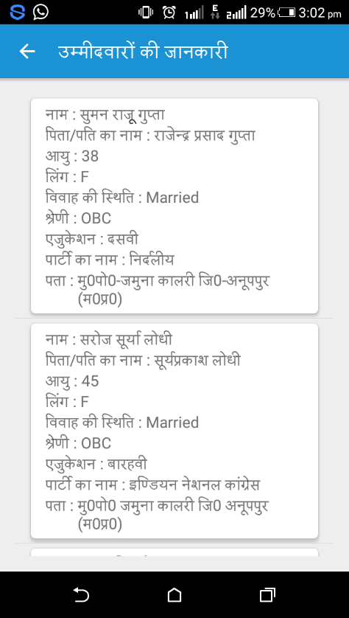
Mobile App - Features
E -Voter slip
Polling station on map
Election results
Candidate information

Slide 11
GIS
  All voters and houses tagged on map
  Local bodies and ward boundaries on map
  Locate polling station on map
  Locate voter’s house on map
  Get directions of polling station from voter’s house on map
  Find information regarding reservation status, candidates and election results on map
  Decision support system to facilitate ward delimitation, polling station formations etc.
  New methodology adapted using mobile app. Successful pilot done for 2 ULBs.
Successfully done for 57 ULBs

Slide 12
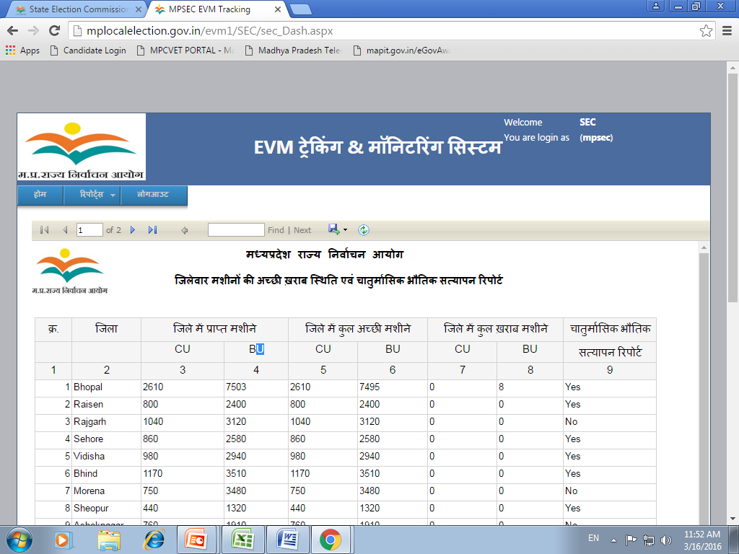
EVM tracking and monitoring system
  End to end management of EVMs from procurement to operation at polling station
  Master stock register
  Regular quality/first level checking
  Rectification of hardware issues
  DEO and RO level randomization
  Commissioning and delployment
  MIS reports

Slide 13
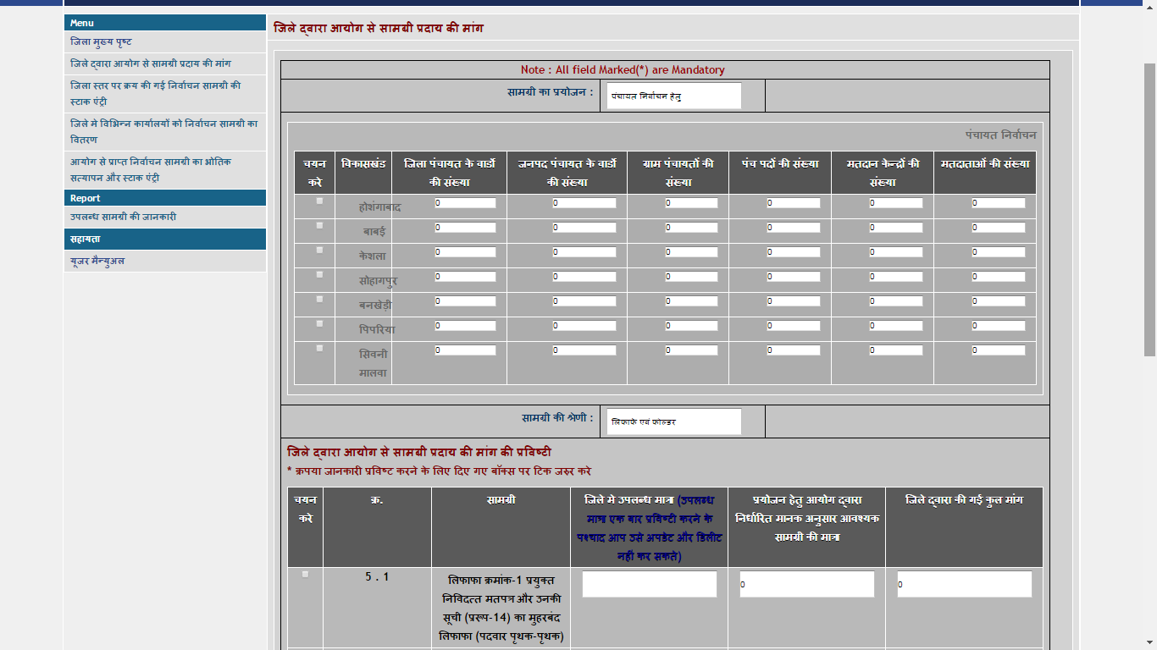
Material management system
  IT based application to manage election related materials
  Distribution of approximate 320 types of election materials to districts
  Capturing demand from districts about election materials
  Provide distribution information to districts
  Inventory management at district and Commission level
  MIS reports

Slide 14
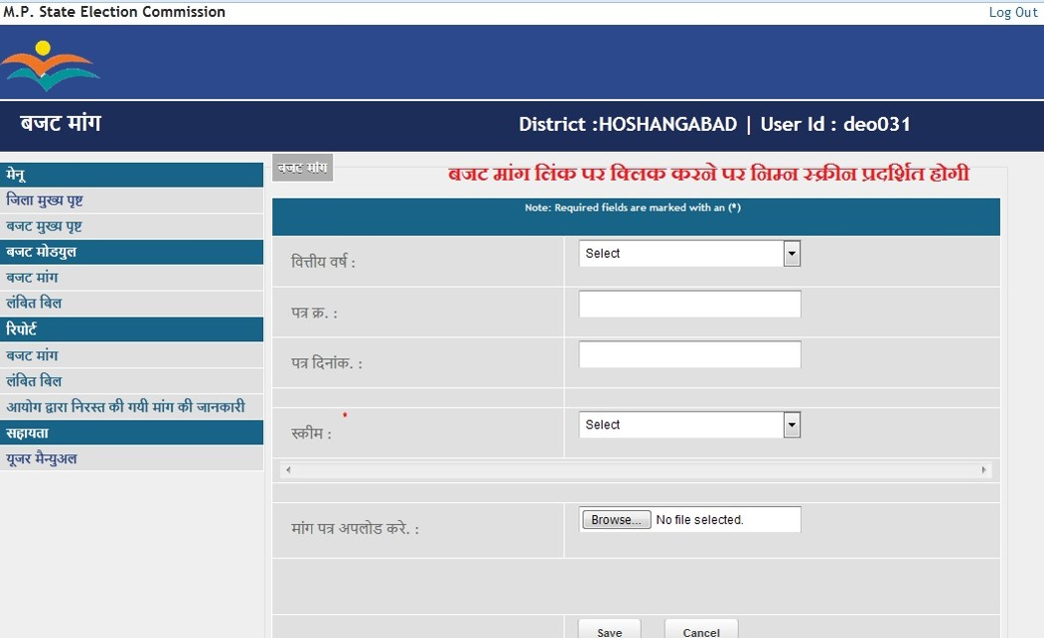
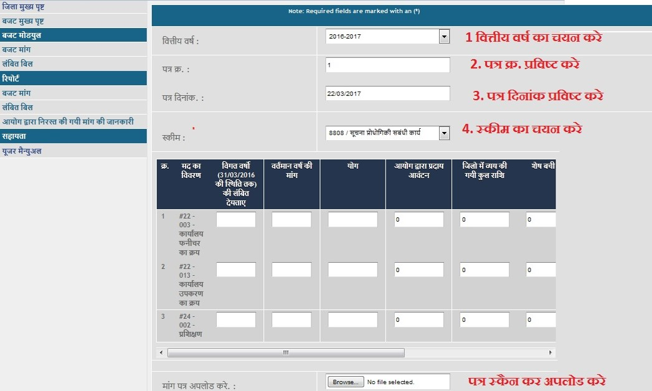
Budget management system
  IT enabled online application to manage budget demands of districts
  Extensively used by all districts to raise their budget demand in last financial year
  Districts raise their demand and upload pending bills for verification
  Commission verify and fulfil budget demands
  MIS reports to monitor and track the demands

Slide 15
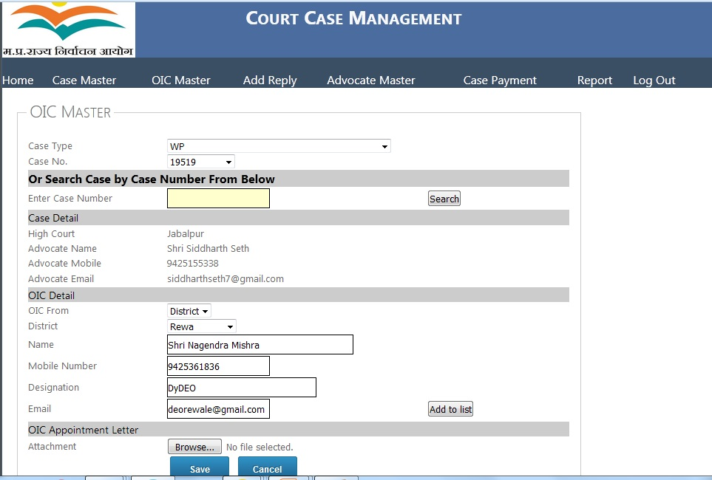
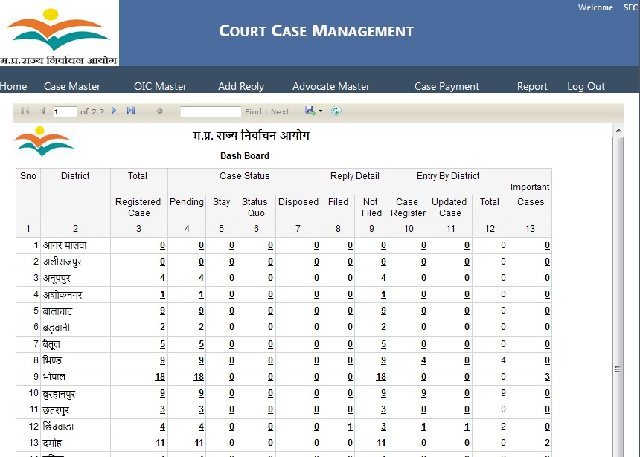
Court case management system
  IT enabled online application to manage various court cases related to Commission
  Online inventory of all the court cases
  Cases can be uploaded by districts and Commission
  Maintain OIC and advocate information
  Maintain case status online (pending/disposed/stay etc)
  MIS reports to monitor cases

Slide 16
Thank You

